Slide 1
Chemotaxis Chemical Concentration with CFD
Tim Davison
Advisors:
Dr. Nickels, Dr. Nguyen

Slide 2
Introduction
This project: Uses computational fluid dynamics to model interactions of the chemotaxis performing robot with the environment (Colloidal Lattice Boltzmann)
Model a chemical source with wind by solving advection/diffusion equations
Method computes concentration at each point in the complex environment and feeds to existing controller

Slide 3
Objectives
Understand existing CLB MATLAB code coupled with Rapid Cell
Generate solution for 2D advection/diffusion equation to output concentration with MATLAB PDE Toolbox or other, pre-existing PDE Solver
Implement solution into existing Rapid Cell code using output from LBM
Testing and validation
Document and report results

Slide 4
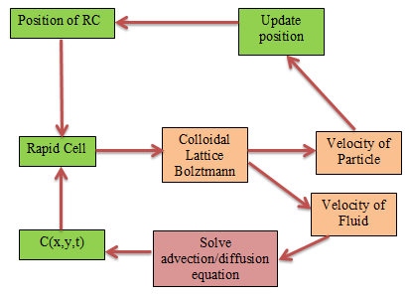

Slide 5
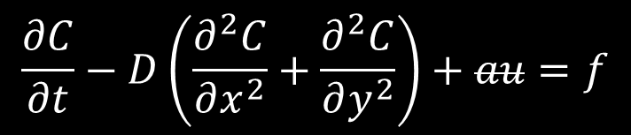
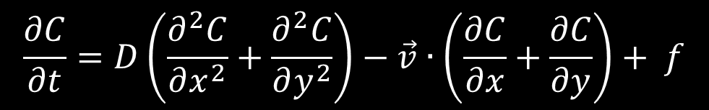

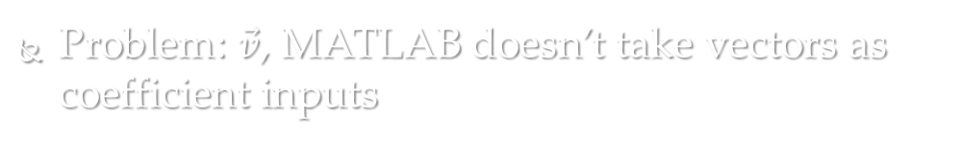
Trying to solve in MATLAB
Advection/diffusion equation
$$\frac{∂C}{∂t}=D\left(\frac{∂^{2}C}{∂x^{2}}+\frac{∂^{2}C}{∂y^{2}}\right)−\vec{v}∙\left(\frac{∂C}{∂x}+\frac{∂C}{∂y}\right)+ f$$
MATLAB’s parabolic PDE form:
-$a∙\left(\frac{∂C}{∂x}+\frac{∂C}{∂y}\right)$
$$\frac{∂C}{∂t}−D\left(\frac{∂^{2}C}{∂x^{2}}+\frac{∂^{2}C}{∂y^{2}}\right)+au=f$$
Problem: $\vec{v}$, MATLAB doesn’t take vectors as coefficient inputs

Slide 6
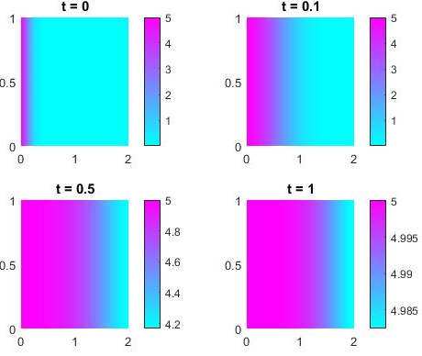
First attempt
Boundary condition: constant concentration on left side of box
Define: f = ‘-5*ux – uy’
Constant advection in x and y directions
Not what I want

Slide 7
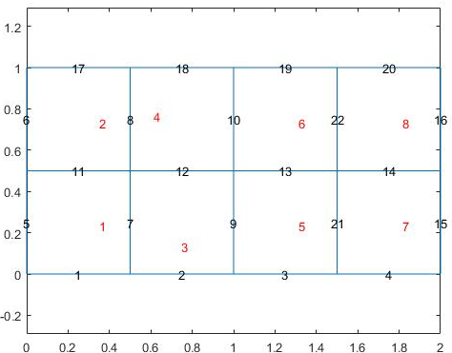
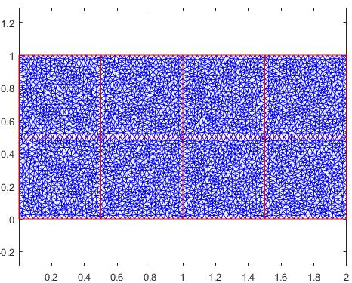
Vector field attempt
Split big 2x1 region into 4x2 smaller sub-regions
Approximate Cx, Cy in each mesh triangle
Define coefficient in each sub-region by corresponding position in velocity field matrix

Slide 8
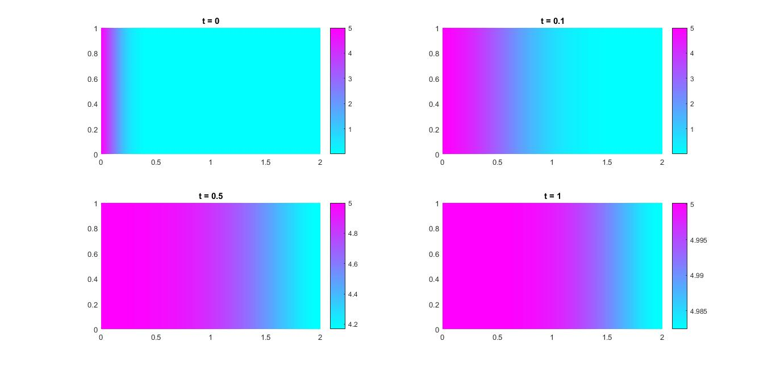
Results

Slide 9
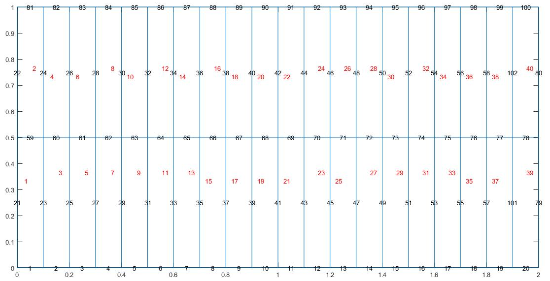
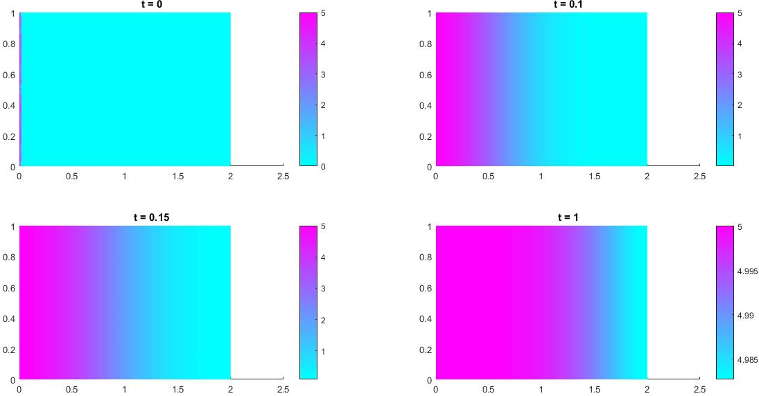
20x2 sub-regions

Slide 10
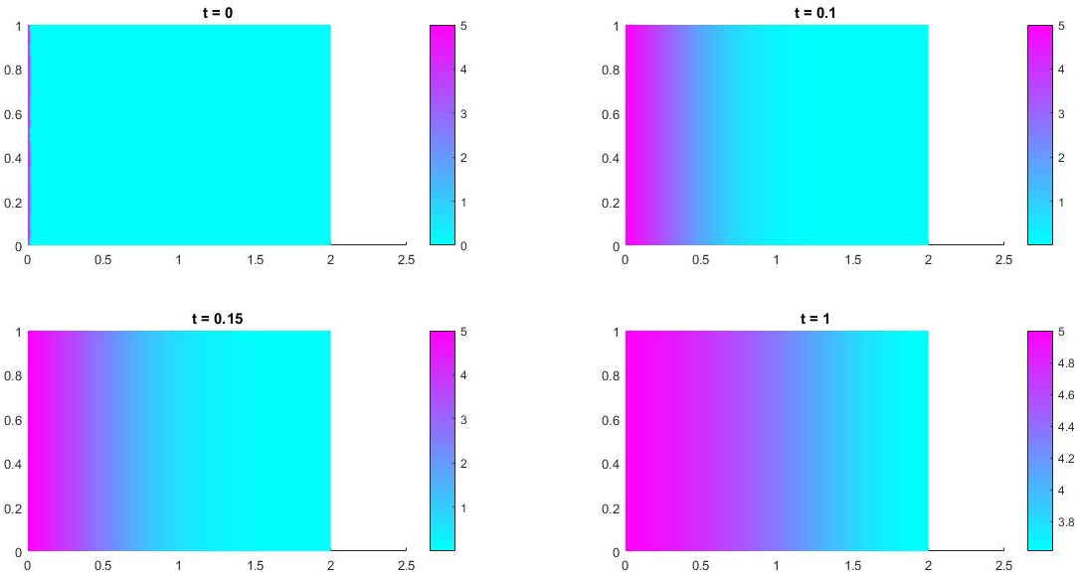
Using sub-set of LBM output
Use 20x2 sub-matrix of 400x200 LBM vector field matrix in x and y
LBM code run with force in x direction

Slide 11
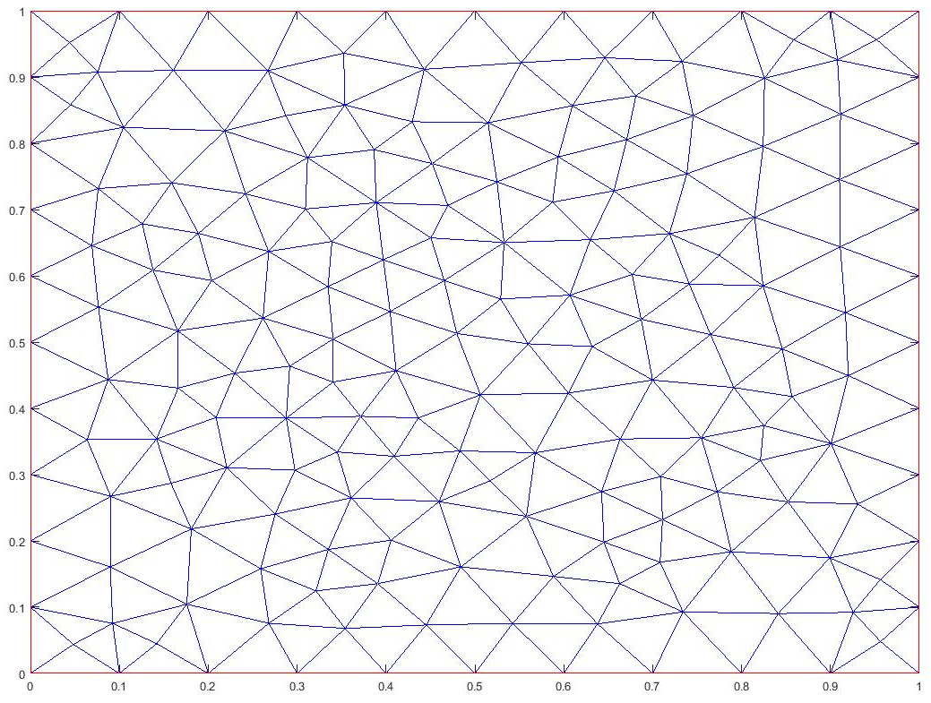
Method 2
With 400x200 velocity field → a lot of sub-regions → not very user/computer friendly
Mesh generation creates # of triangles
C is solved at the centroid of each triangle
Interpolate velocity field to solve for velocity at each centroid → velocity vector→ vx & vy
Use string coefficient command?
f = ‘vx.*ux – vy.*uy’
ERROR

Slide 12
Method 2 cont.
Use Method 1, but instead of creating regions for each lattice point → interpolate velocity to each centroid
Evaluate and create column of f coefficients
Almost there…

Slide 13
Conclusions
I have something that ‘works’
Turns out objective 2 was ambitious
Objective 3: Testing and Validation
May involve some re-working of solution
Should I go in a different direction?

